Slide 1



Performance Bookings
x
Launch Presentation

Slide 2
Paid Media Account Audit
Early Wins & Insights
Target Audience Review
Competitive Analysis
Table of Contents
ROAS Analysis & Goals
Campaign Strategy
Campaign Media Plan
Campaign Details
12-Month Roadmap

Slide 3
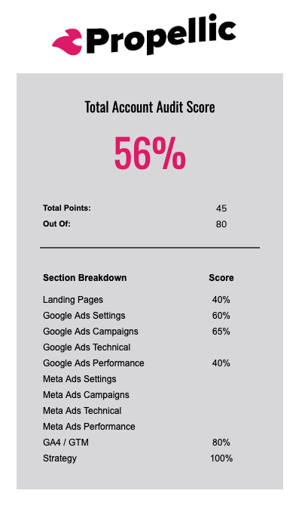
Paid Media Account Audit
Paid Media Audit
Insights & Actions
Our deep paid media account audit uncovered many areas of opportunity that we have been able to optimize early in our engagement. A few of the most notable include:
Lack of Google Ad extensions left competitor ads achieving higher positions and visibility in the SERP.
High use of broad match keywords without audience targeting segmentations produced a high % of spend not resulting in desired outcomes.
Lack of retargeting within the campaigns reduced the opportunity to reach previous visitors as they finalize their booking decisions.
View Paid Media Account Audit

Slide 4

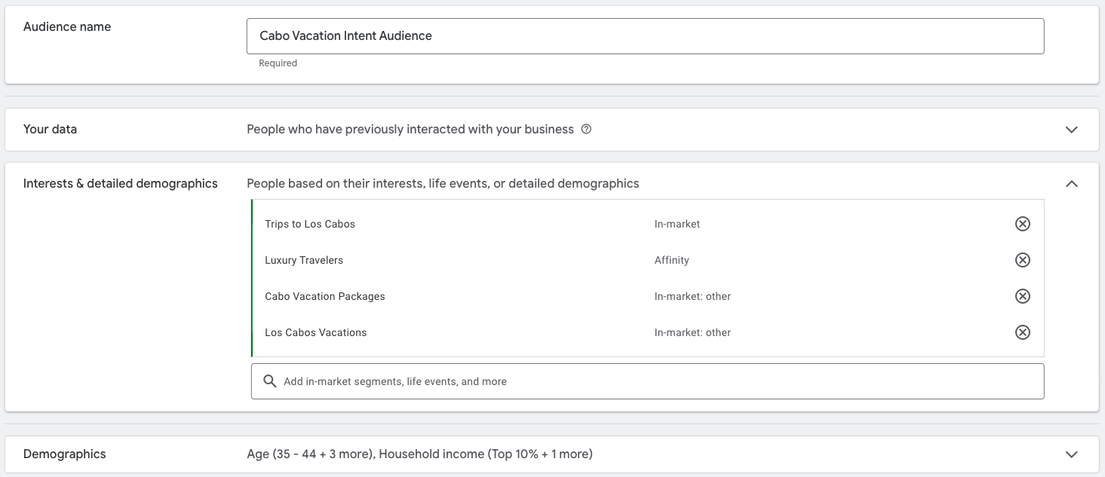
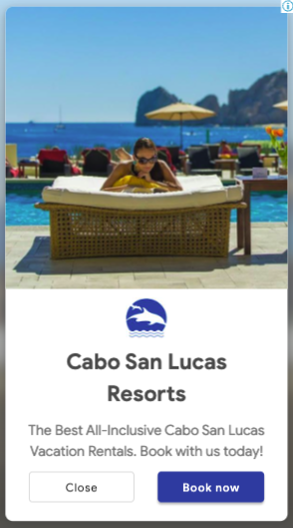
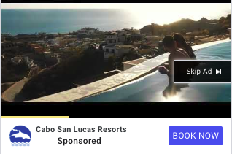
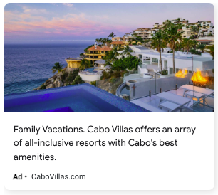
Early Wins
New Performance Max Campaign Drives a 60% Cost/Conv Improvement
The expansion into targeted P-Max high-intent campaigns has already produced significant high-intent interest and volume, driving 12 bookings since launch.
Serving ads on the right medium for your specific audience improves user experience with visual media; inspiring their next journey
Notes:
Paul

Slide 5
Meet Your Target Audience
Detailed Profiles

Slide 6

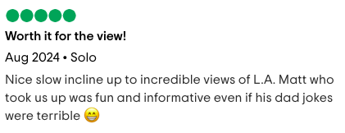
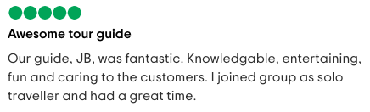
Target Audience Profile: Young Solo Travelers
Where They Live
Demographics
Majority are from the United States, although reviews show visitors from all over the world. 15% are local to the Los Angeles DMA.
Ages 19 - 35
All income ranges
Students & Young Professionals
Interests
What They Wish For
Los Angeles and Hollywood
Instagram & TikTok
Hiking
Low cost, a fun hike, a short activity to fill their agenda, and a great view for selfies.
Currently In-Market
What Are They Saying?
Audience is likely already in the area and In market for fun and affordable things to do in the Los Angeles area.
Travel Habits
Short-term planners
Instagram-worthy locations

Slide 7

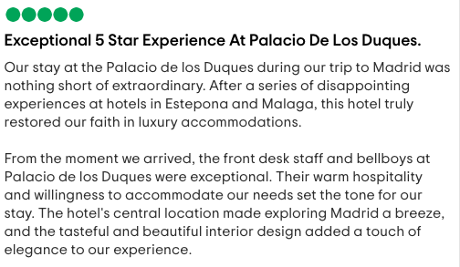
Target Audience Profile: Affluent Empty-Nesters
Where They Live
Demographics
Affluent suburbs in the United States, with a focus on New England.
30% of travelers from the UK and DE
Ages 45-65
High income earners and professions
Newly retired
Masters-level education
Interests
What They Wish For
Spain & European experiences.
Wineries and luxury tours.
Luxury shopping
Fine dining
5-star experiences, relaxation and luxury. Although affluent, they will seek out discount VIP travel.
Currently In-Market
What Are They Saying?
In-market for luxury European travel accommodations in the next 6-10 months.
Travel Habits
Long-Term Planners
Luxury Accommodations
First-Class Ticket Holders
Travel Points Aficionados

Slide 8
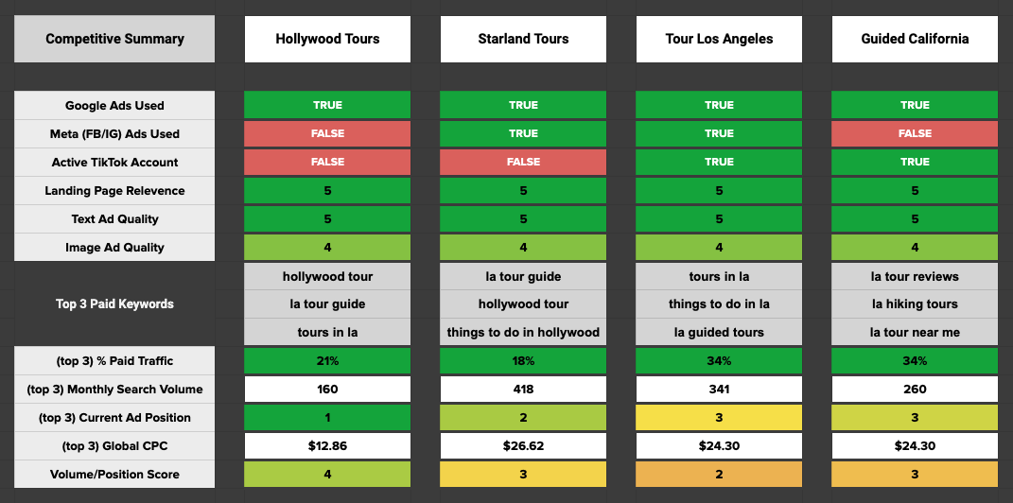
Competitive Analysis
Competitor Review
Callouts & Insights
Tour Los Angeles currently has a strong social media presence and is active on TikTok, which is driving brand recognition.
Tour Los Angeles currently has a strong social media presence and is active on TikTok, which is driving brand recognition.
Tour Los Angeles currently has a strong social media presence and is active on TikTok, which is driving brand recognition.
View Full Analysis

Slide 9
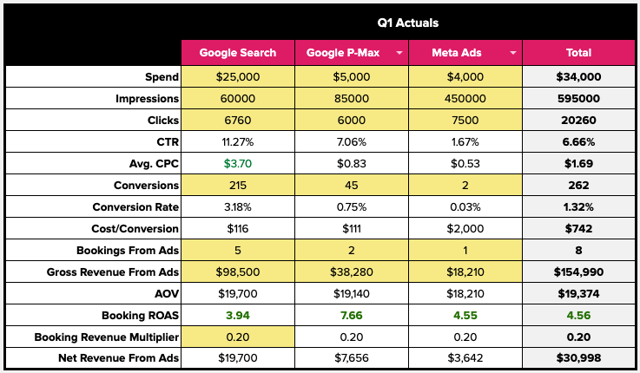
ROAS Analysis
Historical data allows us to uncover optimization shifts as we plan for the upcoming quarter. A few key insights:
Meta Ads Engagement Enhancement: Focusing on targeting the right audience and delivering visual and memorable ads that appeal to their intent stage.
Expand and Optimize PMax: Tightening target intent signals and increasing investment will allow us to leverage the high ROAS.
Budget Distribution: Upcoming budgets will be distributed based on this historical data to maximize bookings and gain the most return as we test and optimize lower-performing channels.
View Full Analysis
Notes:
Paul

Slide 10
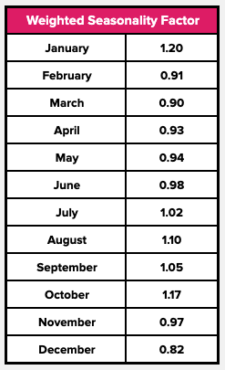
Seasonality Analysis
Analyzing your search campaign keywords and historical performance, we have identified the following seasonal trends that will be leveraged in our forecasting and seasonal strategies.
High Season: July, August, September
Low Season:
Shoulder Season:
We have identified an additional boost in January which confirms your data that this month is used for booking and planning summer travel, which will be consistent with our intent strategy planning.
Notes:
Paul

Slide 11
Travel Intent Strategy
Defining Your Campaign Plan

Slide 12
Traveler Intent Drives Strategy
We map your marketing campaigns
to specific phases of Traveler Intent.
Informational
Commercial
Transactional
All Intent
Advocate
INSPIRE
ENGAGE
BOOK
CAPTIVATE
REFLECT
Where should I go?!
What are my options there?
Who am I booking with?
How can I further enrich my experience?
How was the trip… and what’s next!?
38 Days
33 Days
73 Days
Notes:
Paul

Slide 13
Campaign Strategy
Our Strategy Aligns Traveler Intent With Messaging That Highlights Your Value Proposition
Hollywood Tours provides unforgettable hikes with picture-perfect views, insider access, and engaging guides, creating the ideal adventure for solo travelers, couples, and groups.
Notes:
Paul

Slide 14
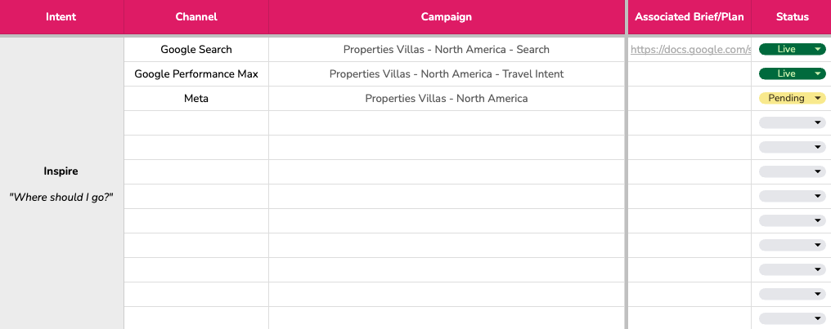
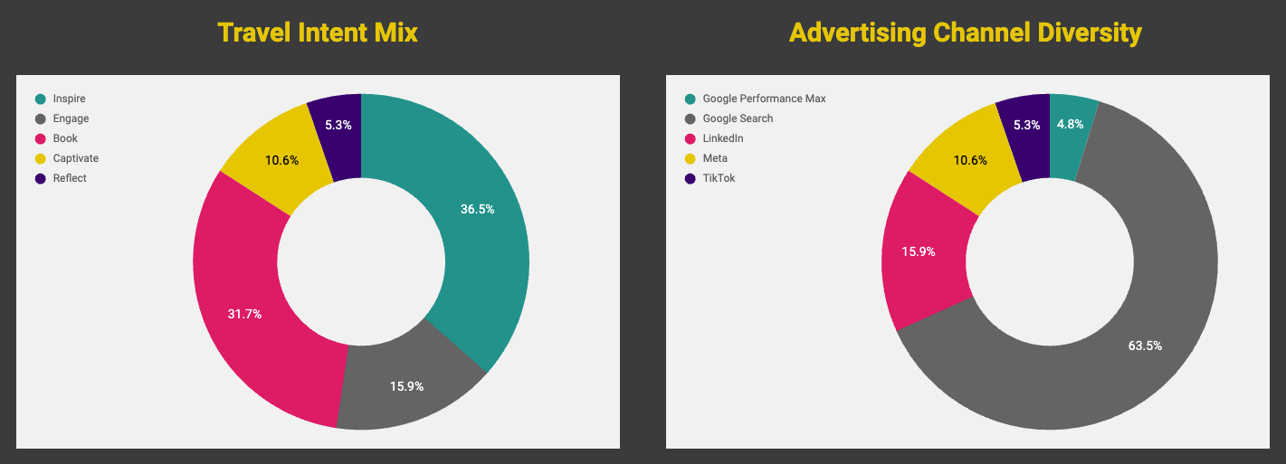
Diversified Media Plan
Travel Intent Media Mix
Our initial media plan builds off of what you have to a more diversified mix, designed to model an intent flow strategy over time.
This media plan will allow us to scale intent and channel opportunities to align with seasonal demands.
Review Detailed Media Plan
Notes:
Paul

Slide 15
Campaigns that Inspire
Notes:
Paul

Slide 16
Campaigns that Engage
Notes:
Paul

Slide 17
Campaigns that Drive Bookings
Notes:
Paul

Slide 18
Campaigns that Captivate
Notes:
Paul

Slide 19
Campaigns for Reflection
Notes:
Paul

Slide 20

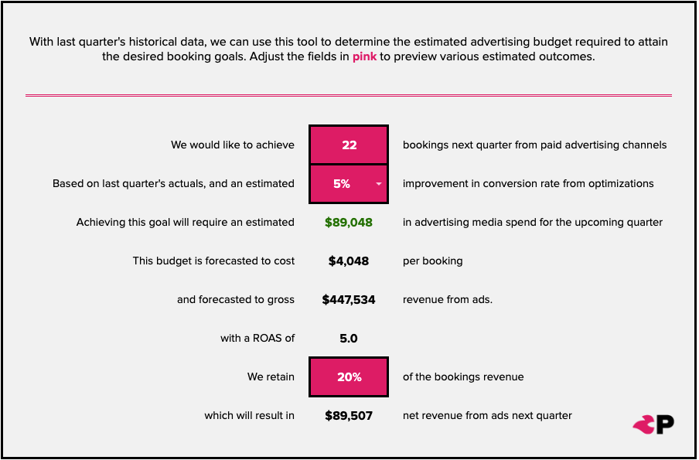
North Star Goal
With a $90000 budget allocated to media spend, we have leveraged our financial model to develop a channel media mix and seasonal distribution to maximize return.
We expect the upcoming quarter will achieve or exceed a north star goal of
22 Bookings
Review Detailed Forecast
Notes:
Paul

Slide 21
Scale & Growth
Planning for What’s Next

Slide 22
12-Month Roadmap
Goal | Q1 Restructure | Q2 Expand | Q3 Optimize | Q4 Scale
Opportunity
Strategy
Planning
 | Q1 Initiatives | Q2 Initiatives | Q3 Initiatives | Q4 Initiatives
 | ROAS-focused campaign adjustments and restructure. | Focus campaign alignment on travel intent stages and prepare campaigns for the high-season | Prepare shoulder-season campaign initiatives for longer-term planning. | Create and plan inspiration intent initiatives and creatives, including new channel assessments.
Seasonality | Low | Shoulder | High | Shoulder
Ongoing | Advertising Optimization, Discoverability, Conversion Management & Reporting
Restructure for Growth
New Channel Opportunities
Goal
Goal
Intent Alignment
Goal
Shoulder Plan
Goal
Inspiration
Plan
QBR
Plan
QBR
Plan
QBR
Plan

Slide 23
Resources: Strategy-Defining Analyses & Deliverables
Quick access links to your onboarding deliverables
Tracking Health Audit
ROAS Analysis & Goal Setting
Initial audit of conversion tracking and attribution.
Financial analysis and goal setting for performance measurement.
Paid Media Account Audit
Campaign Media Plan
A deep audit of your paid media account and campaigns.
Ongoing campaign tracker and strategy scorecard.
Competitive Analysis
Reporting Dashboard
An overview comparison of your brand and top 3 competitors.
Real-time performance dashboard for a quick performance overview.
Target Audience Analysis
An overview comparison of your brand and top 3 competitors.

Slide 24


Thank you!
www.propellic.com

Slide 25




Inspire travel experiences with Paid Social
Remarket to offer visitors, target users in-market or actively engaged with content specifically related to your target destination and actively researching travel.
Capture audiences that are actively engaged with content specifically related to your target destination or activity to inspire research and interest.

Slide 26
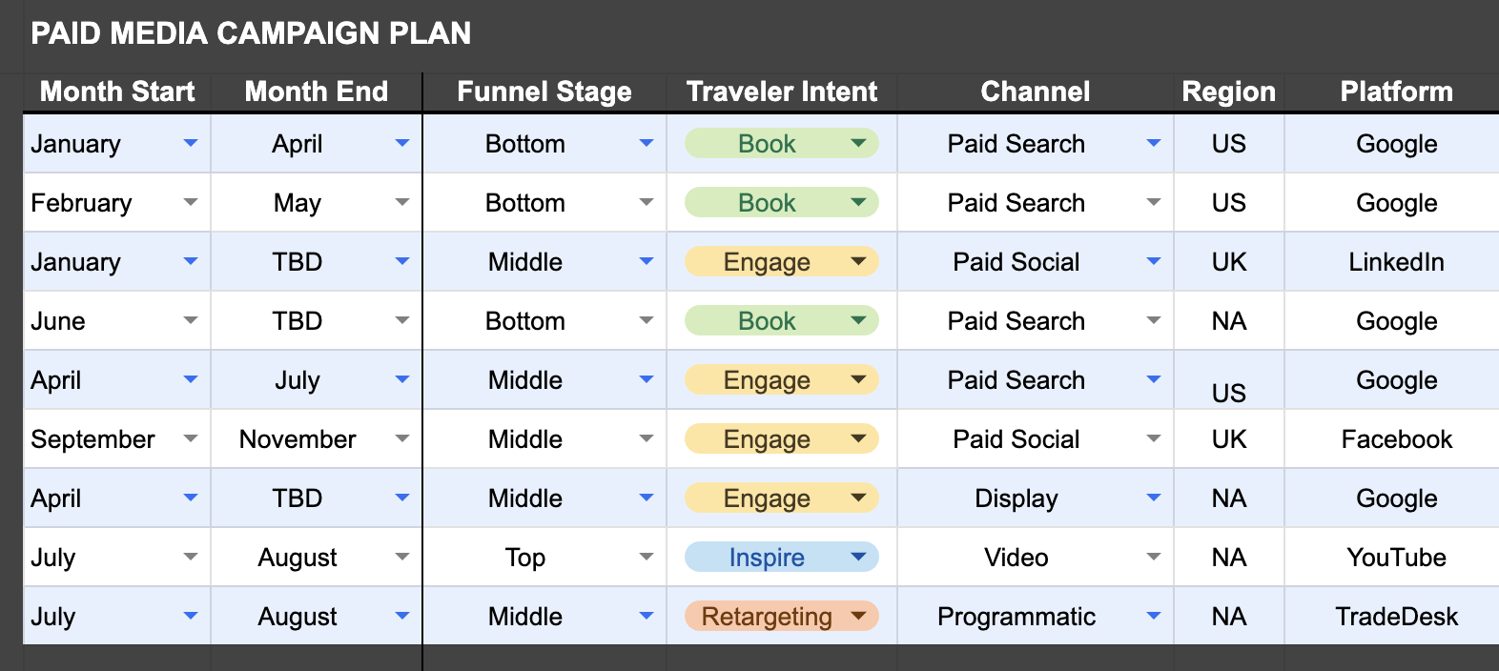
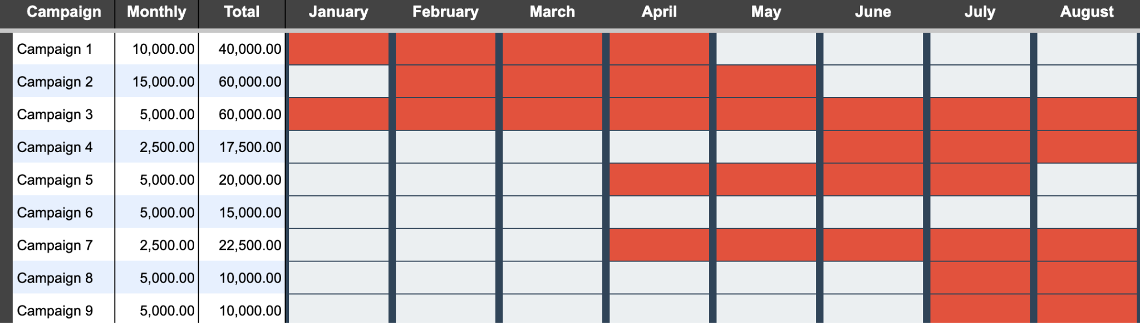
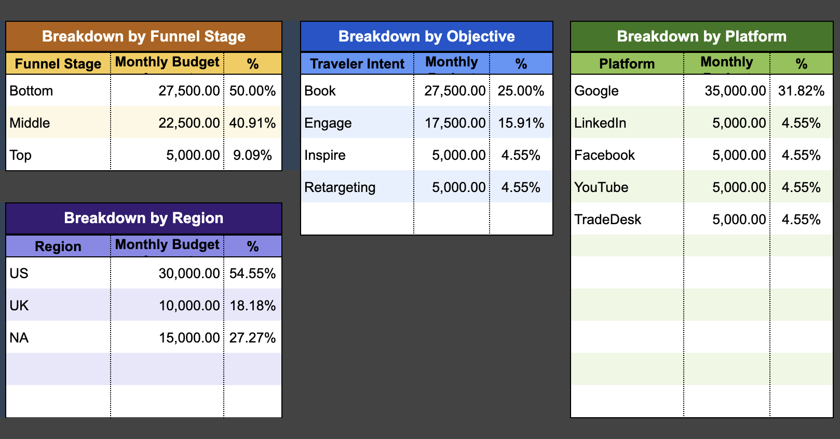
Traveler Intent Unlocks Bookings
Paid Media Strategy
Traveler Intent
Guides Paid Media
We develop comprehensive campaign media plans with the optimal media mix to reach and convert your traveler audience.
This includes budget recommendations across each channel for sufficient testing, specific ad types and their alignment with traveler journey stage - with a focus on our top-performing channels and ad types, over-indexing for down-funnel conversions
Real-time campaign data informs future media-mix adjustments as needed.
Notes:
Paul

Slide 27
Dynamic Strategy
Travel Marketing Maturity: Where are you?
Startup
Foundation
Balanced
Growth
Advanced Growth
Sophisticated Growth
We’re growing and need more efficiency, optimization, and channel diversity.
We’re setting up our channels and learning how marketing can drive revenue.
We do not have established marketing benchmarks.
We’re optimizing our channel(s) and ready to invest in driving more marketing led bookings.
We have some benchmarks and tracking setup.
We have multiple, integrated channels, tech & data - and need to understand how to leverage them to maximize bookings revenue.
We’re scaling and need advanced paid & organic forecasting, strategy, and ongoing optimization.
Phases of Maturity
Notes:
With this one,

